Slide 1
Global Infrastructure Management Business Update
© 2013, Zensar Technologies. All Rights Reserved.
.
Vivek Gupta and Tom Tucker
20th February, 2013

Slide 2
Agenda
Industry View
Year 1 (FY12) – Integration
Year 2 (FY13) – Consolidation
Year 3 (FY14) – Leveraging
© Zensar Technologies 2013
2

Slide 3
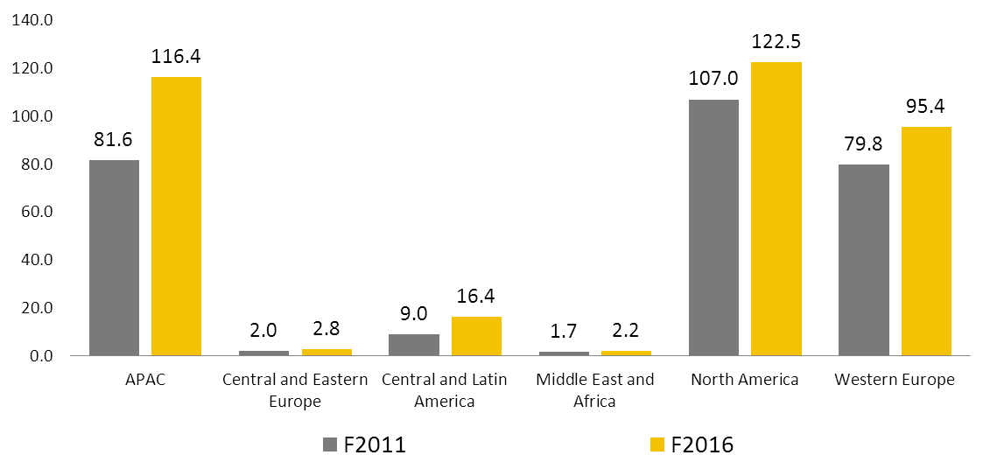
Global IM Opportunity - By Geography
Market Size : $269B in 2011, $355B in 2016
Source: Ovum
© Zensar Technologies 2013
3

Slide 4
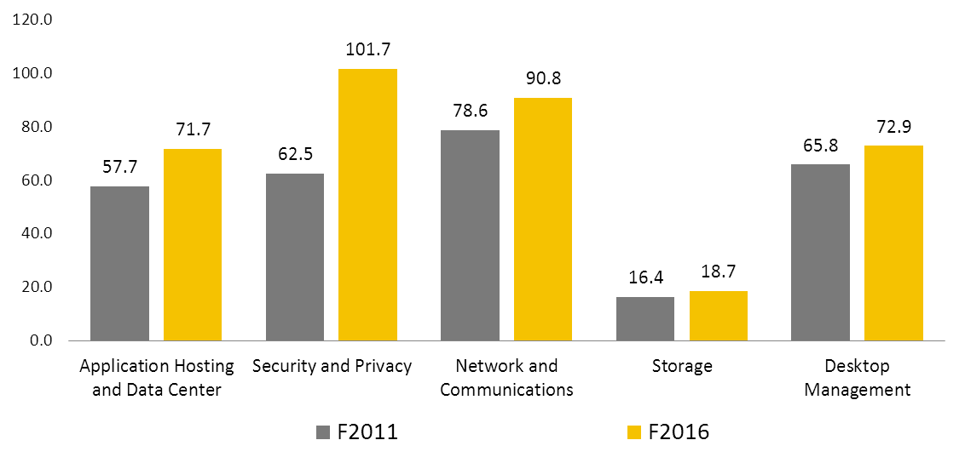
Global IM Opportunity - By Service
Market Size : $269B in 2011, $355B in 2016
Source: Ovum
© Zensar Technologies 2013
4

Slide 5
Global IM Opportunity - By Verticals
Source: Ovum’s Global IT Services Forecast Model – June ‘11
© Zensar Technologies 2013
5

Slide 6
Zensar Akibia Integration
Zensar
Akibia
RIMS & Service Desk
Shared Services
ITIL Process Consulting
Exchange Migration
Network
Server & Storage
Database & Messaging
Integrated Story
Multivendor Data center support & maintenance
OEM Alliances
Risk & Compliance management
Network Security solutions
Only 50-70% service spectrum covered
Only 40-50% service spectrum covered
© Zensar Technologies 2013
6

Slide 7
Strategic Objective
To achieve $400m Revenue from IM by FY17
Akibia
Data Center services and Multi-Vendor Support
Remote Infrastructure Management
Security
and
Compliance
End User Computing services
Zensar
© Zensar Technologies 2013
7

Slide 8
The Integration focus in FY12
Crafting the complete services portfolio
Cross selling
Going after large deals
Building a seamless Global IM business
Common branding
© Zensar Technologies 2013
8

Slide 9
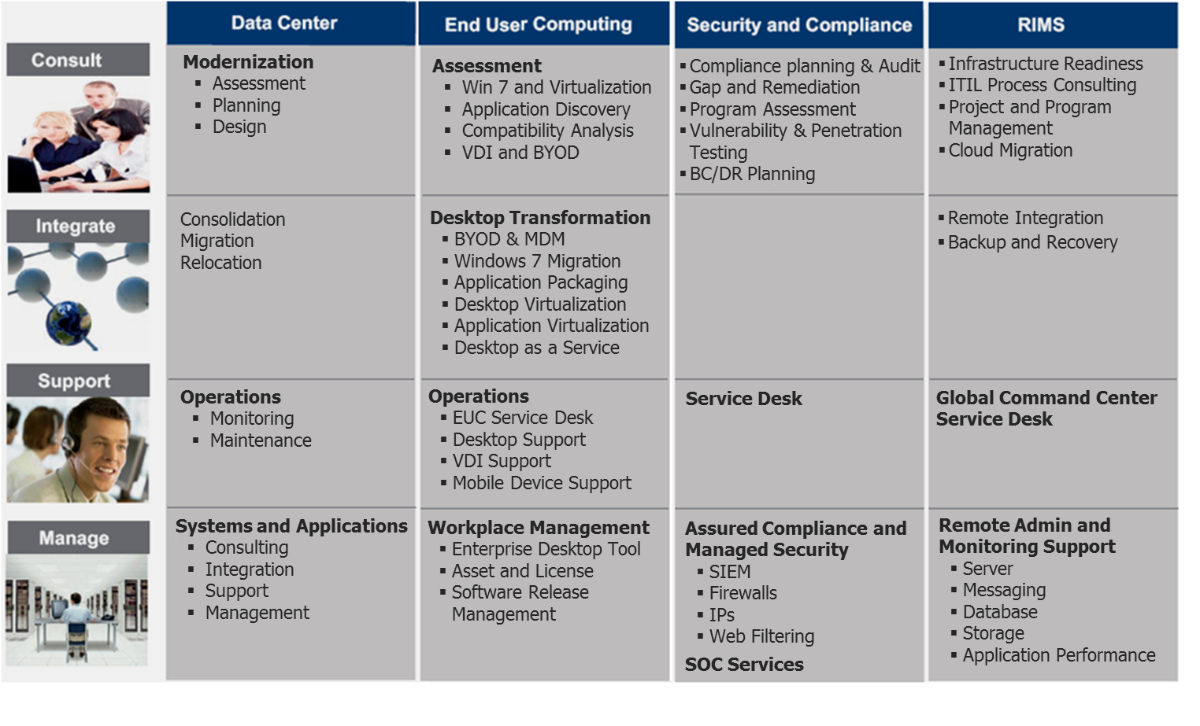
The Integrated IM Services Portfolio
© Zensar Technologies 2013
9

Slide 10
Current year (FY13) - Consolidation
Focus on large deals (long lead times)
Launch of “Total Infrastructure Outsourcing” (first success)
Shift of work offshore (short term drop in revenues)
Closing of low value non-scalable engagements
Global re-launch of MVS
© Zensar Technologies 2013
10

Slide 11
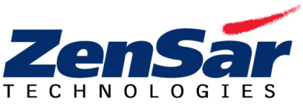
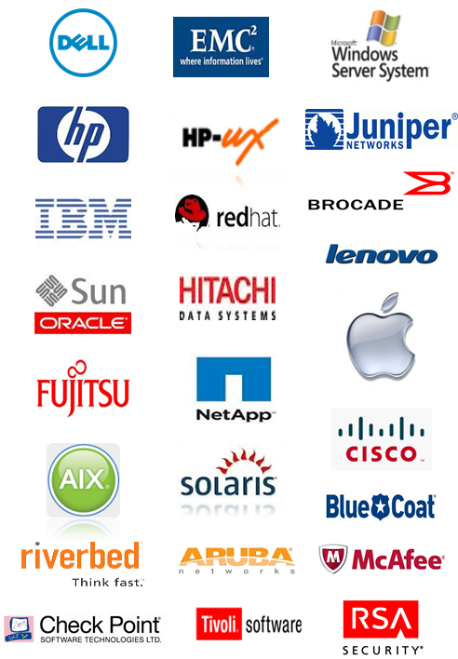
Zensar’s Multi-Vendor Support
Infrastructure Components
One Stop MVS Provider
Server
Storage
Network
OS
EUC
Service Providers
Single point of contact for all infrastructure support
Unified and integrated processes for all systems
Global 24x7x365 multi-lingual help desk and local field support
One contract and one bill
Customer
Data Centers
© Zensar Technologies 2013
11

Slide 12
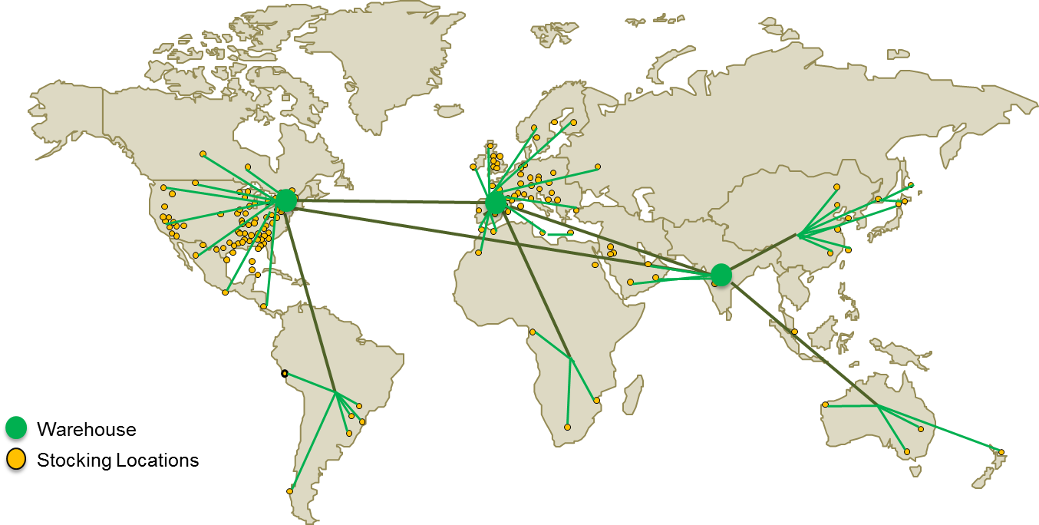
Zensar’s Global Logistics
State of the art IT systems
180 strategic stocking locations
Supporting over 500,000 units
Across140 countries
© Zensar Technologies 2013
12

Slide 13
Current State – The Good and The Bad
Wins
H1 = $ 7M / Q3 = $ 20M
Under Pursuit
Total value of large opportunities = $ 105M
Sales opportunities
Total Infrastructure Outsourcing (TIO)
Multi-Vendor support - a unique positioning amongst Indian IT companies
Migration to hybrid cloud infrastructure
Global integrated multi-lingual service desk capability
Go-to-market
Moving work offshore
Exit from non-growth accounts
Long lead times for large deal closures
Drop in revenue
© Zensar Technologies 2013
13

Slide 14
Current State – The Good and The Bad
2012
2013
April | May | June | July | Aug | Sep | Oct | Nov | Dec | Jan | Feb | Mar
Large Deals
(USD)
$50M
$120M
$105M
$7M
$20M
$13M
Win
(USD)
Cloud
Euro MVS
First TIO
© Zensar Technologies 2013
14

Slide 15
What we are seeing today
Most analysts, except Ovum, bullish about growth in IM in 2013
IM continues to be an arrowhead for most IT companies
Zensar is among only a few that have global MVS (Breakfix) capability
Uniquely placed among Tier-2s
© Zensar Technologies 2013
15

Slide 16
Outlook for FY14
Healthy opening large deal pipeline
TIO & MVS to be main arrowheads
Verticalization of IM offerings
Single brand & logo globally
© Zensar Technologies 2013
16

Slide 17
Service Alignment
Trends
Services
Cloud
Big Data
Mobile
Consulting Services
Assessment services geared to identify savings potential as a precursor to Total Infrastructure Outsourcing
Verticalized Service Offerings
Data Center Services (DCS)
Managed Services for On-Premise / Hosted Private Clouds
Enhance Virtualization and Consolidation Capabilities
Storage Management
End User Computing (EUC)
Managed Mobility Services
Enhanced Virtualization Services
Security and Compliance (S&C)
Compliance in the Virtual and Cloud Environments
Data Security and Privacy
Remote Infrastructure Management (RIMS)
Integration capability for Monitoring and Management Tools
Single Pane of Glass View
Infrastructure
Security
© Zensar Technologies 2013
17

Slide 18
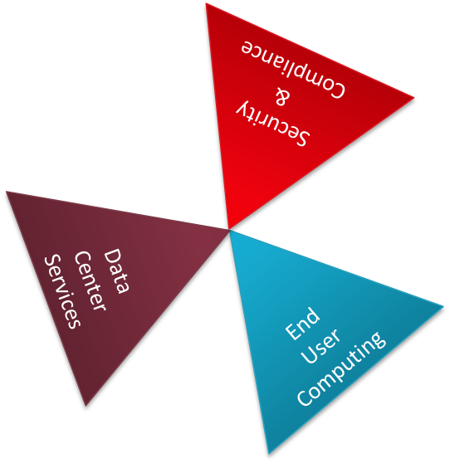
Global IM Business Model
MULTI-SHORE DELIVERY
MULTI-LINGUAL DELIVERY
AKIBIA SALES
(US, EU)
VERTICALS SALES
(ROW)
VERTICALS SALES
(US, EU)
© Zensar Technologies 2013
18

Slide 19
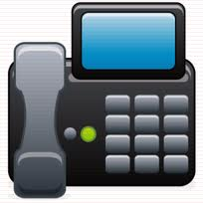
Global Integrated Framework
Infrastructure as a Service
Service Desk
Contact Center
Enterprise Cloud Computing
Virtual and Physical Servers
VoIP Network across:
Westborough
Veenendaal
Shanghai
Pune and Hyderabad
Contact Center
Intelligent Call Routing
Hosted / Premise ACD
IVR and Speech
Security
On Demand Services
Vulnerability Management
Firewall
Messaging Service
Server Monitoring
Network Monitoring
Database Monitoring
Storage Management
Security Devices
Global IP Partner Network
Reporting
Risk Management
Compliance Management
Secure Gateway
Data Center Solutions
Unified Communication
Westborough
Veenendaal
Shanghai
Pune and Hyderabad
MVS
Consolidation
Migration
Hybrid Cloud
Cloud Switch
Unified Messaging
Managed Reporting
Web Conferencing
© Zensar Technologies 2013
19

Slide 20
Thank you

